Slide 1
On the String Matching with k Differences in DNA Databases
Yangjun Chen and Hoang Hai Nguyen
Dept. of Applied Computer Science
University of Winnipeg, Canada
Notes:
Thank you very much, everybody. Welcom to my presentation. My name is Yangjun Chen. I’m now a professor at University of Winnipeg, Canada.
The talk I’m going to present today is on a method to do the string matching with k differences in DNA databases.

Slide 2
Outline
Motivation
- Statement of Problem
- Related work
Basic Techniques
- Dynamic programming
- BWT Arrays – A space-economic Index for String Matching
Main algorithm for string Matching with k Differences
- Search trees
- Suffix trees over patterns, Similar paths, Pattern partition
Experiments
Conclusion and Future Work
Notes:
Here is the outline of my talk.
First, the motivation of this work. For this, we will show you what is the string matching with k differences. Why it is important and interesting , attracting us spending a lot of time on this. Then, the related work.
Next, I will discuss two techniques used by our method. One is the dynamic programming paradigm, and the other is the so-called BWT transformation applied to a target DNA sequence, generating another array, called the BWT array.
Based on these two techniques, we will discuss our main algorithm for the string matching with k differences. Specifically, I will discuss the concept of search trees, which will be created by executing our algorithm, and three other techniques to improve the performance of the basic algorithm. They are the suffix trees over patterns, recognition of similar paths in a search tree, as well as a pattern partition strategy.
Next, I’ll report the test results and empirically compare our method with some existing noteworthy methods.
Finally, I will conclude the talk with a brief discussion on the future work.

Slide 3
Statement of Problem
String matching with k differences: to find all the occurrences of a pattern string x = x₁x₂ … x_{m} in a target string y = y₁y₂ ... y_{n} with at most k differences, where x_{i}, y_{j} ∈ ∑, a given alphabet. In general, we distinguish among three kinds of differences:
A character of the pattern corresponds to a different character of the target. In this case we say that there is a mismatch between the two characters;
A character of the target corresponds to ''no character'' in the pattern (an insertion into the pattern); and
A character of the pattern corresponds to ''no character'' in the target (a deletion from the pattern).
3
Notes:
By the string matching with k differences, we will find all the occurrences of a pattern x in a target string y … …
… Just as shown by this example. By this example, we have “p” in the pattern corresponds “c” in the target.
…. Just as shown here. Here, we have “f” in the pattern corresponds to nothing in the pattern.
…. Just as shown here. Here we have “p” in the pattern corresponds to nothing in the target.

Slide 4
Statement of Problem
String matching with k differences:
to find all the occurrences of a pattern string x = x₁x₂ … x_{m} in a target string y = y₁y₂ ... y_{n} with at most k differences.
Example:
k = 3
b p d q e g h
pattern
c b c d
e f g h i
target
4
Notes:
To know what is that, let’s have a look at this example. By this example, we are given a pattern and a target, and required to find all the occurrences of the pattern in the target with at most 3 differences. However, by this alignment, we can find only one occurrence, by which we can see three differences: one is “p in the pattern corresponds to c” in the target, “q in the pattern corresponds to nothing in the target”, and “nothing in the pattern corresponds to f in the target”.

Slide 5
Related Work
Exact string matching
- On-line algorithms:
    Knuth-Morris-Pratt, Boyer-Moore, Aho-Corasick
    - Index based:
suffix trees (Weiner; McCreight; Ukkonen), suffix arrays (Manber, Myers), BWT- transformation (Burrow-Wheeler), Hash (Karp, Rabin)
Inexact string matching
String matching with k mismatches - Hamming distance (Landau, Vishkin; Amir at al.; Cole; Chen, Wu)
String matching with k differences - Levelshtein distance (Chang, Lampe)
String matching with wild-cards (Manber, Baeza-Yates)
Notes:
Now, something about the related work.
Since early 70’s last century, a lot of research has been done on the string matching problem. In general, we distinguish between two kinds of string matching problems. One is the exact string matching and the other is the inexact string matching. For the exact string matching, we further distinguish between the on-line algorithms and the index-based strategies. For the on-line algorithms, we have Knuth-Morris-Pratt algorithm, Boyer-Moore algorithm. But the Aho-Corasick algorithm is designed to solve the multiple pattern matching problem.
For the inexact string matching, we further distinguish between three kinds of string matching problem. That is, the String matching with k mismatches, by which the Hamming distance function is used to count the distance between two substrings; the String matching with k differences, by which the Levelshtein distance function is used to count the distance between two substrings; (in comparison with k matches, the string matching with k differences is more error-tolerant) and the string matching with wild-cards. A wild-card matching matches any character, including another wild-card.

Slide 6
Basic Techniques
Dynamic Programming
- to calculate distance between pattern and
targets
BWT transformation
- to ‘fold’ the target strings
Notes:
By our method for the string matching with k differences, two techniques are used. One is the dynamic programming paradigm, which is mainly used to compute the distance between the pattern and a substring of the target. The other is the BWT transformation of a target string, by which the target string is folded in some way so that the search of the target string can be done fast.

Slide 7
Dynamic Programming
- X_{i} = x₁x₂ … x_{i}
- Y_{j} = y₁y₂ … y_{j}
Time complexity: O(mn)
D(0, j) = j, 0 ≤ j ≤ n; D(i, 0) = i, 0 ≤ i ≤ m;
D(i – 1, j) + w(x_{i}, φ)
D(i – 1, j - 1) + δ(x_{i}, y_{j})
D(i, j - 1) + w(φ, y_{j})
D(i-1, j-1)
D(i-1, j)
D(i, j) = min
D(i, j-1)
D(i, j)
where w(x_{i}, y_{j}) is the cost to change x_{i} to y_{j}, and δ(x_{i}, y_{j}) is 1 if x_{i} = y_{j}. Otherwise δ(x_{i}, y_{j}) = w(x_{i}, y_{j}).
7
Notes:
In the following, I’ll first show you how the dynamic programming paradigm works, by which the distance between a prefix of the pattern and a prefix of the target is calculated by using this formula. Here, D(I, j) is the distance between the prefix of the pattern X_{i} and the prefix of the target Y_{j}. This is recursive equation. At each step, to get D(I, j), we must first compute three values, and then take the minimum value of the three values as the value for D(i, j).

Slide 8
Dynamic Programming
Example: X = gcaca, Y = acatatg, k = 2. For each y_{j}, the distance between y₁…y_{j} and x₁…x_{i} for all x_{i} will be calculated.
 | j | 0 | 1 | 2 | 3 | 4 | 5 | 6 | 7
i |  |  | a | c | a | t | a | T | g
0 |  | 0 | 0 | 0 | 0 | 0 | 0 | 0 | 0
1 | g | 1 | 1 | 1 | 1 | 1 | 1 | 1 | 0
2 | c | 2 | 2 | 1 | 2 | 2 | 2 | 2 | 1
3 | a | 3 | 2 | 2 | 1 | 2 | 2 | 3 | 2
4 | c | 4 | 2 | 2 | 2 | 2 | 3 | 3 | 3
5 | a | 5 | 4 | 3 | 2 | 3 | 2 | 4 | 4
Notes:
To know how it works, let’s have a look at this example. By this example, the pattern X is a string gcaca, and the target Y is a string acatatg. We set k = 2. That means, we will find all the substrings of Y, whose distance from the pattern X is smaller than or equal to 2. For this purpose, we will scan Y from left to right and for each encountered character y_{j}, we will calculate the distance between the prefix y₁ … y_{j} and the prefix x₁ … x_{i}.
At the very beginning, we initialize the the first row and the first column. Then, calculate the values in the matrix column by column.
First, we calculate this value by using these three values. Then, calculate this value by using these three values, and so on when we scan the target string Y from left to right.
If a value in the last row is 2 or less than 2, then it indicates a substring in Y, whose distance from the pattern is 2 or smaller than 2.
For example, in this row we have two two’s, indicating two occurrences of the pattern in the target.

Slide 9
BWT Transformation
BWT array L of y, denoted as BWT(Y), can be established by using the suffix array SA of y:
L[i] = $,
if SA[i] = 0;
L[i] = y[SA[i] – 1],
otherwise.
BWT array was proposed by M. Burrows and D.J. Wheeler in 1994. (M. Burrows, D.J. Wheeler, (1994), A block sorting lossless data compression algorithm, Technical Report 124, Digital Equipment Corporation.)
9
Notes:
Now we show you the second technique we have used for designing our algorithm. It is the so-called BWT transformation. By the BWT transformation, we will transform the target string Y to another string, called a BWT array by using the suffix array in terms of this formula. That is, we will first create the suffix array SA[ ]of the target string. Then, create the BWT array of the target string in terms of the relationship between these two arrays, specified by this formula.
To know what it is, let’s have a look at the following example.

Slide 10
BWT Transformation
Suffix | Sorted suffix | SA_{y} | r_{F} | F | Sorted rotations | L | r_{L}
gtataca$ | $ | 7 | - | $ | $g₁t₁a₁t₂a₂c₁a₃ | a | 1
tataca$ | a$ | 6 | 1 | a | a₃$g₁t₁a₁t₂a₂c₁ | c | 1
ataca$ | aca$ | 4 | 2 | a | a₂c₁a₃$g₁t₁a₁t₂ | t | 1
taca$ | ataca$ | 2 | 3 | a | a₁t₂a₂c₁a₃$g₁t₁ | a | 2
aca$ | ca$ | 5 | 1 | c | c₁a₃$g₁t₁a₁t₂a₂ | a | 2
ca$ | gtataca$ | 0 | 1 | g | g₁t₁a₁t₂a₂c₁a₃$ | $ | -
a$ | taca$ | 3 | 1 | t | t₂a₂c₁a₃$g₁t₁a₁ | a | 3
$ | tataca$ | 1 | 2 | t | t₁a₁t₂a₂c₁a₃$g₁ | g | 1
L = BWT(Y)
Notes:
To know how it works, let’s have a look at an example.
Assume that the target string is gtataca. We attach a special symbol to the end of the string, which is different from any character of the string so that each suffix cannot be a prefix of any other suffix.
Then, we generate all its suffixes and sort them alphabetically as shown here, and store the positions of the first character of each suffix in an array, called a suffix array. In terms of this array, we can immediately get the BWT array as shown here. Since a suffix can be generated in linear time, a BWT array can also be created in linear time.
The generation of BWT arrays can be described in a quite different way, by which we first rotate the target string consecutively and generate 8 strings and sort them alphabetically. Then, write then stacked vertically as shown here. We notice that the last column of this matrix is just the BWT array while in the first column all the characters are clustered. What is important, using a relationship between these two columns, we can do the string matching very fast.
Finally, we notice that the characters in the string are subscripted, showing their ranks, in which they appear in the original target string.

Slide 11
BWT Transformation
Burrows-Wheeler Transform (BWT)
y = g₁t₁a₂t₂a₃c₁a₃$
Rank correspondence:
Suffix Array
BWT construction:
  rk_{F}
  -
  1
  2
  3
  1
  1
  1
  2
F
L
  rk_{L}
  1
  1
  1
  2
  2
  -
  3
  1
  g₁ t₁ a₁ t₂ a₂ c₁ a₃ $
  t₁ a₁ t₂ a₂ c₁ a₃ $ g₁
  a₁ t₂ a₂ c₁ a₃ $ g₁ t₁
  t₂ a₂ c₁ a₃ $ g₁ t₁ a₁
  a₂ c₁ a₃ $ g₁ t₁ a₁ t₂
  c₁ a₃ $ g₁ t₁ a₁ t₂ a₂
  a₃ $ g₁ t₁ a₁ t₂ a₂ c₁
  $ g₁ t₁ a₁ t₂ a₂ t₂ a₃
  $ g₁ t₁ a₁ t₂ a₂ t₂ a₃
  a₃ $ g₁ t₁ a₁ t₂ a₂ c₁
  a₂ c₁ a₃ $ g₁ t₁ a₁ t₂
  a₁ t₂ a₂ c₁ a₃ $ g₁ t₁
  c₁ a₃ $ g₁ t₁ a₁ t₂ a₂
  g₁ t₁ a₁ t₂ a₂ c₁ a₃ $
  t₂ a₂ c₁ a₃ $ g₁ t₁ a₁
  t₁ a₁ t₂ a₂ c₁ a₃ $ g₁
  7
  6
  4
  2
  5
  0
  1
  2
L[i] = $,
if SA[i] = 1;
rank: 3
L[i] = y[SA[i] – 1],
otherwise.
SA[…] – suffix array
A suffix array can be established in O(n).
Sort these sequences lexicographically.
  rk_{F}(e) = rk_{L}(e)
rank: 3

Slide 12
Backward Search of BWT-Index
y = g₁t₁a₁t₂a₂c₁a₃$
x = tata
<z, [α, β]>,
if z appears in L_{π};
search(z, π) =
φ,
otherwise.
Backward Search
Z: a character π: a range in F
L_{π}: a range in L, corresponding to π
F L
$ a₃
a₃ c₁
a₂ t₂
a₁ t₁
c₁ a₂
g₁ $
t₂ a₁
t₁ g₁
F L
$ a₃
a₃ c₁
a₂ t₂
a₁ t₁
c₁ a₂
g₁ $
t₂ a₁
t₁ g₁
F L
$ a₃
a₃ c₁
a₂ t₂
a₁ t₁
c₁ a₂
g₁ $
t₂ a₁
t₁ g₁
F L
$ a₃
a₃ c₁
a₂ t₂
a₁ t₁
c₁ a₂
g₁ $
t₂ a₁
t₁ g₁
Notes:
To see why the BWT arrays can be used to speed up the sting matching, let’s have a look at an example, in which we will find all the occurrences of X in Y. For this, we will search X backwards since the search of L and F just corresponds to the search of the original target sequence, but in the reverse direction.
First, we check the last character of X. It is a. Then, we will find the first and last appearances of a in L. It is a₃ and a₁, by which this segment in F can be determined. Next, we will check t in X. (It is the second character from the last in X.) And we will find the first and last appearances of t in this segment of L, by which this segment in F will be determined. In the third step, we will check a in X. (It is the third character from the last in X.) Again, we will find the first and last appearances of a in this segment of L, by which this segment in F will be determined. Finally, we will check t in X. (This is in fact the first character of X.) In the same way, we will find the first and last appearances of t. It is t₁, showing that there is one occurrence of X in Y at position t₁.

Slide 13
Backward Search of BWT-Index
S(t, <a, [1, 3]>)
S(a, <t, [1, 2]>)
S(t, <a, [3, 3]>)
Search sequence:
<a, [1, 3]>
<t, [1, 2]>
<a, [3, 3]>
<t, [2, 2]>
F L
$ a₃
a₃ c₁
a₂ t₂
a₁ t₁
c₁ a₂
g₁ $
t₂ a₁
t₁ g₁
F L
$ a₃
a₃ c₁
a₂ t₂
a₁ t₁
c₁ a₂
g₁ $
t₂ a₁
t₁ g₁
F L
$ a₃
a₃ c₁
a₂ t₂
a₁ t₁
c₁ a₂
g₁ $
t₂ a₁
t₁ g₁
F L
$ a₃
a₃ c₁
a₂ t₂
a₁ t₁
c₁ a₂
g₁ $
t₂ a₁
t₁ g₁
Notes:
The above working process can be represented as a searching sequence as shown here, in which each pair represents a segment in L and the pair following it is produced by a searching operation to find the first and the last appearance of the currently encountered character in the pattern.
If the searching operation can be completed in constant time, the string matching needs only a time linear in the length of the pattern string.

Slide 14
rankAll
Arrange |Σ| arrays each for a character x ∈ Σ such that A_{x}[i] (the ith entry in the array for x) is the number of appearances of x within L[1 .. i].
Instead of scanning a certain segment L[α .. β] (α ≤ β) to find a subrange for a certain x ∈ Σ, we can simply look up A_{x} to see whether A_{x}[α - 1] = A_{α}[β]. If it is the case, then α does not occur in α .. β]. Otherwise, [A_{x}[α - 1] + 1, A_{x}[β] ] should be the found range.
F L
$ a₃
a₃ c₁
a₂ t₂
a₁ t₁
c₁ a₂
g₁ $
t₂ a₁
t₁ g₁
  A$ A_{a} A_{c} A_{g} A_{t}
  0 1 0 0 0
  0 1 1 0 0
  0 1 1 0 1
          0 1 1 0 2
          0 2 1 0 2
          1 2 1 0 2
  1 3 1 0 2
  1 3 1 1 2
Example
To find the first and the last appearance
of t in L[1 .. 3], we only need to find
A_{t}[1 – 1] = A_{t} [0] = 0 and A_{t} [3] = 2. So the
corresponding range is
[A_{t}[1 - 1] + 1, A_{t}[3]] = [1, 2].
Notes:
But by using a data structure, the so-called rankAll, the operation to find the first and last appearances of a certain character within a segment of L can really be done in constant time. Thus, the time complexity of the string matching is O(m) linear in the length of the pattern.

Slide 15
Reduce rankAll-Index Size
F-ranks: F_{α} = <a; x_{a}, y_{a}>
BWT array: L
Reduced appearance array: A_{α} with bucket
size β.
Reduced suffix array: SA* with bucket size γ.
Find a range:
top′ ← F(x_{α}) + A_{α}[ ⎣(top -1)/β⎦ ] + r +1
bot′ ← F(x_{α}) + A_{α} [ ⎣bot/β⎦] + r′
r is the number of α's appearances within
L[⎣(top - 1)/β⎦ β .. top - 1]
r’ is the number of α's appearances within
L[⎣bot/β⎦ β .. bot ]
F L rk_{L}
$ a₃ 1
a₃ c₁ 1
a₂ t₂ 1
a₁ t₁ 2
c₁ a₂ 2
g₁ $ -
t₂ a₁ 3
t₂ g₁ 1
SA
F_{α} = <α; x_{α}, y_{α}>
L
a₃
c₁
t₂
t₁
a₂
$
a₁
g₁
  A$ A_{a} A_{c} A_{g} A_{t}
  0 1 0 0 0
  0 1 1 0 0
  0 1 1 0 1
          0 1 1 0 2
          0 2 1 0 2
          1 2 1 0 2
  1 3 1 0 2
  1 3 1 1 2
SA*
  7
  6
  4
  2
  5
  0
  1
  2
  7
  6
  4
  2
  5
  0
  1
  2
  F$ = <$; 1, 1>
  F_{a} = <a; 2, 4>
  F_{c} = <c; 5, 5>
  F_{g} = <g; 6, 6>
  F_{t} = <t; 7, 8>
+
+
+

Slide 16
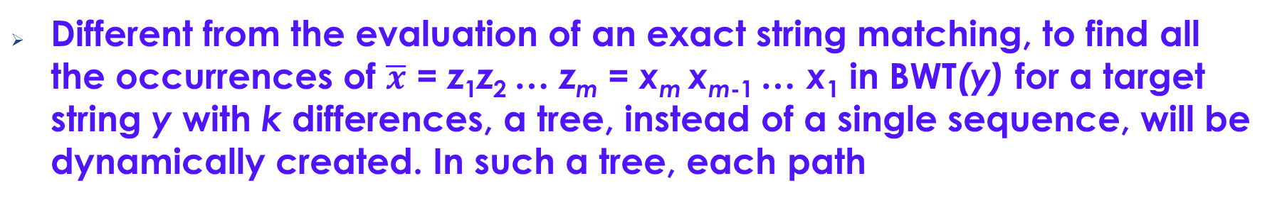
String Matching with k Differences
Different from the evaluation of an exact string matching, to find all the occurrences of $\overline{x}$ = z₁z₂ … z_{m} = x_{m} x_{m-1} … x₁ in BWT(y) for a target string y with k differences, a tree, instead of a single sequence, will be dynamically created. In such a tree, each path
v₀ → v₂ → … → v_{l}
corresponds to a search sequence. Each v_{j} is labeled with <e_{j}, [α_{j}, β_{j} ]>. The D-vector of v₀ is <0, 1, …, m>^{T}.
For j > o, we have
D_{j}[0] = D_{j-1}[0] + 1
D_{j}[i] = min{D_{j}[i -1] + w(z_{i}, φ), D_{j-1}[i] + w(φ, e_{j}), D_{j-1}[i - 1] + δ(z_{i}, e_{j}), }, for i > 0.
Notes:
Our method is in fact a combination of the dynamic programming paradigm and the BWT transformation, by which when we search an BWT array against a pattern, at each step, a column in the dynamic programming matrix will be calculated as discussed before.

Slide 17
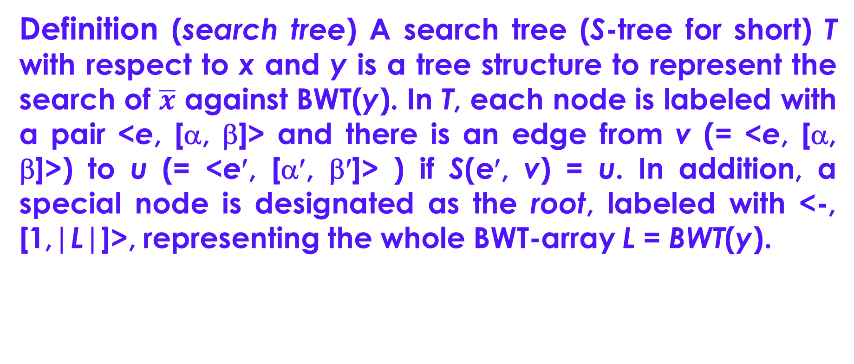
Search Trees
Definition (search tree) A search tree (S-tree for short) T with respect to x and y is a tree structure to represent the search of $\overline{x}$ against BWT(y). In T, each node is labeled with a pair <e, [α, β]> and there is an edge from v (= <e, [α, β]>) to u (= <e′, [α′, β′]> ) if S(e′, v) = u. In addition, a special node is designated as the root, labeled with <-, [1,|L|]>, representing the whole BWT-array L = BWT(y).
Notes:
Since we will find all the occurrences of a pattern string in a target string with k differences, we will not only go along a single search sequence, but along a tree, called a search tree, defined as shown on this slide.
A search tree …

Slide 18
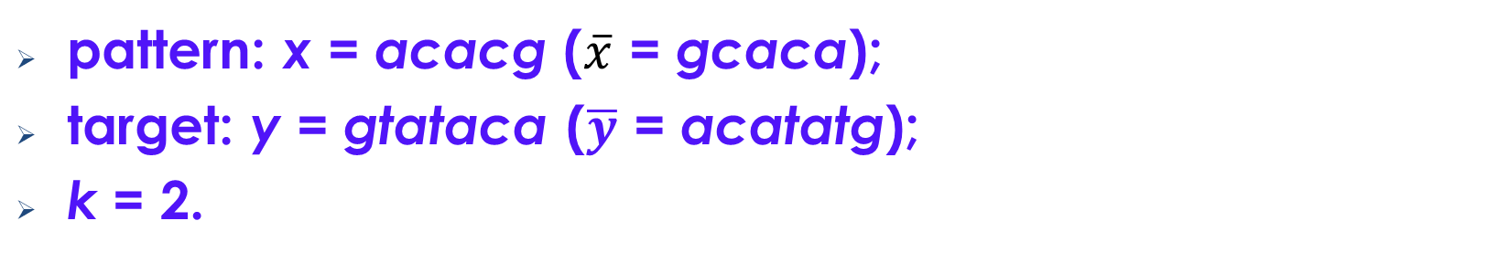
Search Trees
pattern: x = acacg ($\overline{x}$ = gcaca);
target: y = gtataca ($\overline{y}$ = acatatg);
k = 2.
T:
v₀
<-, [1, 8]>
F L
$ a₃
a₃ c₁
a₂ t₂
a₁ t₁
c₁ a₂
g₁ $
t₂ a₁
t₁ g₁
v₁₇
v₁
<a, [1, 3]>
v₉
v₁₃
<t, [1, 2]>
<g, [1, 1]>
<c, [1, 1]>
v₁₀
v₁₄
v₁₆
P₇
v₂
<c, [1, 1]>
v₄
<t, [1, 2]>
<a, [2, 2]>
<a, [3, 3]>
<g, [1, 1]>
v₅
v₈
v₁₀
v₁₅
P₆
v₃
<a, [2, 2]>
<a, [3, 3]>
<g, [1, 1]>
<t, [1, 1]>
<t, [2, 2]>
P₁
v₆
P₃
v₁₁
P₅
<t, [2, 2]>
<a, [3, 3]>
v₇
P₄
<g, [2, 2]>
P₂
Notes:
For example, by searching the BWT array of Y against this pattern, we will create a search tree as shown here. In this tree, each path corresponds to a search sequence we have just discussed. But we should notice that for each node, we will also calculate the corresponding column in the dynamic programming matrix, using the same formula as we have seen before.

Slide 19
String Matching with k Differences
D-vectors:
D₀
-
0
1
2
3
4
5
D₁
a
1
1
2
2
3
4
D₂
c
2
2
1
2
2
3
D₃
a
3
3
2
1
2
2
D₄
t
2
2
2
3
3
4
D₅
a
3
3
3
2
3
3
D₆
t
4
4
4
3
3
4
D₇
g
5
4
5
4
4
4
D₈
g
3
2
3
3
3
4
D₉
c
1
1
1
2
3
5
D₁₀
a
0
1
2
3
4
4
D₁₁
t
3
3
3
2
2
3
D₁₂
a
4
4
4
3
3
2
D₁₃
t
1
1
2
3
4
5
D₁₄
a
2
2
2
2
3
4
D₁₅
t
3
3
3
3
3
4
D₁₆
g
2
1
2
3
4
5
D₁₇
g
1
0
1
3
4
5
Notes:
For example, for the nodes in the search tree we have just seen, we generate several dynamic programming matrices with each being made of the columns along a path in the search Tree.

Slide 20
Computational Complexities
Time complexity
Worst case: O(k⋅|T|)
Average time complexity: O(k⋅|Σ|^{2k})
Space complexity
Worst case: O(km + n)
Existing methods:
time complexity – O(k⋅n); space complexity – O(m + n)
20
20
20
Notes:
Theoretically, the worst-case time complexity of our method is bounded by O(k⋅|T|). Then, the average time complexity of our method is O(k⋅|Σ|^{2k}) since the average size of the search tree T is O(|Σ|^{2k}).
This time complexity is better than the best existing running time O(k⋅n) when k is smaller than log_{|Σ|} n.

Slide 21
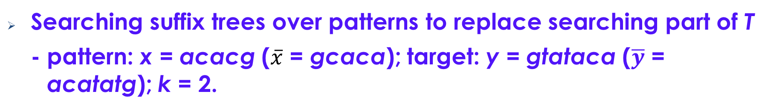
Improvement-1
Searching suffix trees over patterns to replace searching part of T
- pattern: x = acacg ($\overline{x}$ = gcaca); target: y = gtataca ($\overline{y}$ = acatatg); k = 2.
T:
v₀
<-, [1, 8]>
F L
$ a₃
a₃ c₁
a₂ t₂
a₁ t₁
c₁ a₂
g₁ $
t₂ a₁
t₁ g₁
v₁
<a, [1, 3]>
D₄
2
2
2
3
3
4
v₂
<c, [1, 1]>
v₄
<t, [1, 2]>
… …
v₅
v₃
<a, [2, 2]>
<a, [3, 3]>
<g, [1, 1]>
P₁
v₆
P₃
<t, [2, 2]>
v₇
<g, [2, 2]>
P₂
21
21
Notes:
We have two ways to improve our basic algorithm.
One way is to replace part of the search tree T by searching the suffix tree over the pattern. The advantage of doing so is that In the process, it is not necessary to calculate the columns of the dynamic programming matrix for each encountered node.

Slide 22
Improvement-1
Suffix tree over $\overline{x}$ = gcaca
gcaca$
c
a
$
aca$
a$
$
ca$
1
2
3
4
5
6
Notes:
For example, we can replace the part marked grey on the previous slide with the search along the two red paths in this suffix tree over the pattern.
What is important is when we search along these two paths we’ll not calculate the columns in the corresponding dynamic programming matrices.

Slide 23
Improvement-2
Recognizing similar paths
w
<e₀, [α₀′, β₀′]>
<e₀, [α₀, β₀]>
u
w₁
<e₁, [α₁′, β₁′]>
… …
<e₁, [α₁, β₁)]>
u₁
… …
v
[α₀, β₀] ⊆ [α₀′, β₀′]
[α₁, β₁] ⊆ [α₁′, β₁′]
… …
23
Notes:
Another way to improve the basic algorithm is the recognition of similar paths as illustrated by these two paths.
On these two paths, the corresponding nodes have almost the same labels. For example, node u and node w have not only the same character e₀, but the interval of node u is also contained in the interval of node w.
By using this kind of similarity, a lot of time can be saved.

Slide 24
Pattern Partition
As k increases, the performance of our algorithm degrades.
Partition a pattern to get subpatterns with smaller k′ values.
Quickly find all those substrings in a target, which match a subpattern with smaller k′ differences.
For each surviving substring, recheck it to see whether it is an occurrence of the pattern, but with k differences.
Notes:
What is more important is when the number k of the allowed errors is large, the performance of our algorithm will degrade greatly..
In this case, we can Partition a pattern to get subpatterns with smaller k′ values.
Then, for each subpattern, we will find all those substrings in a target, which match the subpattern with smaller k′ differences. In terms of the above analysis, this can be very fast.
Next, for each surviving substring, recheck it to see whether it is really an occurrence of the pattern, but with large k differences.

Slide 25
Pattern Partition
Two-step method: Filtering and Exact matching
Filtering
In the first step, we partition the pattern x = x₁ … x_{m} evenly into l segments, denoted as x = P₁P₂ ... P_{l} with each P_{i} = x_{(i-1)r+1} ... X_{ir}
for 1 ≤ I ≤ l - 1, and P_{l} = x_{(l-1)r+1} … x_{m}, where r = ⎡m/l⎤. Then, we check each P_{i} against BWT(y) with k' = ⎣k/l⎦ differences in turn to find all the occurrences of P_{i} (1 ≤ i ≤ l) in y. Each occurrence is represented by
(i, j), indicating that P_{i} matches a segment ending at position j in y with k' differences.
Notes:
By the method based on the pattern partition, we will make a two-step execution.
In the first step, …

Slide 26
Pattern Partition
Two-step method
Exact checking
In the second step, for each occurrence (i, j) found in the first step, the substring of the target: s_{i,j} = y_{j-ir+1-k} ... y_{j-ir+1+m+k} will be again closely checked against x with k differences by using a classical algorithm. The length of s_{i,j} is m + 2k.
26
Notes:
In the second step, …
The length of each subsegment is bounded by m + 2k.

Slide 27
Pattern Partition
Illustration for pattern partition
m + 2k
target string y
j – I × r + 1 + k
j – I × r + m + k
pattern string x
r
…
r
…
⎡ m/l⎤
P_{i}
Notes:
This process can be pictorially illustrated by this figure, by which we assume that a segment of the target string matches a subpattern as shown here. Then, in the second step, we will check a segment of length m + 2k covering the corresponding matching segment to see whether is any occurrences of the pattern in this segment with k differences.

Slide 28
Experiments
In our experiments, we have tested altogether 7 strategies:
Ukkonen's onlline method (u-o for short, [57]),
Chang-Lawer’s first method (ch-1 for short, [14]),
Chang-Lawer's second method (ch-2 for short, [14]),
Ukkonen's index-based method (u-i for short, [58]),
Myers's index-based method (m-i for short, [44]),
Peri-Culpepper's index-based method (pc-i for short, [49]), and
ours, discussed in this paper.
Notes:
Now I report our test results. In our experiments, we have tested altogether 7 strategies listed here. The first three are all the on-line algorithms while all the rest 4 methods are the index-based.

Slide 29
Experiments
Test bed
All codes are written in C++ and compiled by GNU g++ compiler version 5.4.0 with compiler option `-O2’.
All tests run on a 64-bit Ubuntu OS with a single core of Intel Xeon E5-2637 @3.50Ghz. The system memory is of 64 GB.
Notes:
All the codes of these algorithms are written in C++ language, running on a Unix machine with main memory of 64 GB.

Slide 30
Experiments
Test bed
For time measurements, we used the Unix time commands. In addition, the suffix trees for patterns (in the Chang-Lawler's method and ours), as well as for reference sequences (in the Ukkonen's index-based method) are constructed by using the algorithm described in [59].
To construct the suffix arrays and the BWT-arrays, we used a code found in the libdivsufsort library (https://github.com/
Y256/libdivsufsort)
30

Slide 31
Experiments
Data
Reference sequences* | Num. characters | Time (s) for building BWT(y)
Gorilla | 3,063,403,506 | 406.817
Danio Rerio (ZebraFish) | 1,373,472,378 | 173.142
Gorilla Chr1 | 228,908,641 | 25.03
Protein-1 | 144,000,000 | 15.92
Protein-2 | 30,000,000 | 3.04
*The first three are genome sequences while the last two are protein sequences. For genomes, |Σ| = 4. For protein sequences, |Σ| = 20.
Notes:
For this experiment, we have used three DNA sequences and two protein sequences. All of them are downloaded from the Internet.

Slide 32
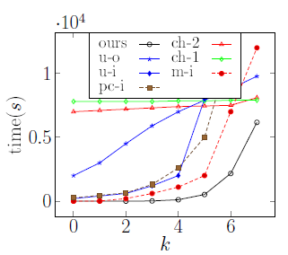
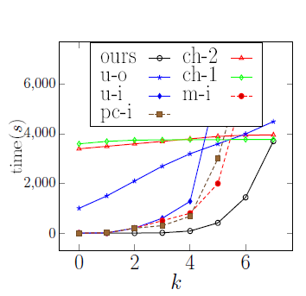
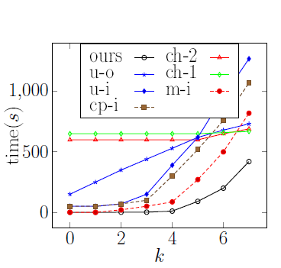
Experiments
Experiments on the string matching with small number of differences
  - Pattern length = 100 characters
  Gorilla genome
  ZebraFish genome
  Gorilla Chr1
Notes:
On this slide, we show the test results over the three DNA sequences: Gorilla genome, ZebraFish genome, and Gorilla Chr1. The tested pattern is 100 characters long.
From these figures, we can see a tremendous difference between our method and all the others when k is small. Specifically, when k is 6, ours is up to 4 times better than the others. When k is 4, ours is up to 65 times faster than the others. When k = 1, ours can be up to 70,000 times better than the others.
However, when k is set to be 7 or larger, the performance of our method quickly degrades and even becomes worse than some of the other methods.

Slide 33
Experiments
  Number of nodes in T (Gorilla)
k | 1 | 2 | 3 | 4 | 5 | 6 | 7
|T| | 1.4k | 25k | 278.5k | 2M | 10M | 39.72M | 92M
Notes:
To have a deep insight into the performance of our method, let’s have at this table, in which we show the sizes of the search trees generated when checking the Gorilla genome with different k values. From this table, we can see that when k is small, the size of the search tree is really very small. This explains why our method is much better than the others in these cases. By the other methods, no matter whether k is small or large, the whole genome sequence has to be checked character by character.
However, as k increases, the size of a search tree quickly increases. This explains why the performance of our method greatly degrades in these cases.

Slide 34
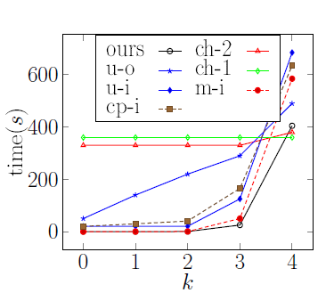
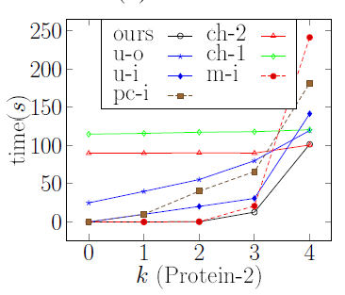
Experiments
  Protein 1
  Protein 2
Notes:
On this slide, we show the test results over protein sequences. From this, we can see that the same claims as for the DNA sequences can be applied to the protein sequences. But we notice that the alphabet of the protein sequences contain up to 20 different characters, a little bit smaller that the alphabet of the English language. This shows that our methods can also be used for the general string matching problem and still has a super performance when k is small.

Slide 35
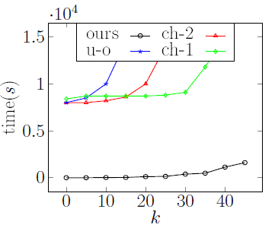
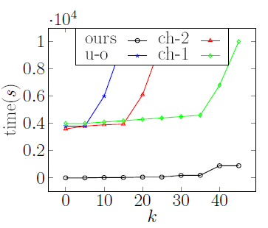
Experiments
Experiments on the string matching with large number of differences (for which the two-step method is used.)
  - Pattern length = 300 characters
  Gorilla genome
  ZebraFish genome
Notes:
On this slide, we show the test results over two genome sequences, but with very large k values. The length of the tested patterns are each 300 characters.
By this test, the pattern partition strategy is used.
First, we note that the test results on all the other index-based methods are not included. It is because the performance of all these methods are much worse than ours, and even worse than all the tested on-line methods.
Second, all the on-line methods are still worse than ours. To show the reason for this, we give the execution details of our method on the next slide.

Slide 36
Experiments
  Two-step execution details on Gorilla genome
k | 20 | 25 | 30 | 35 | 40 | 45
Step-1 | 23.1s | 23.1s | 173.2s | 172.9s | 1187.0s | 1187.5s
Step-2 | 97.41s | 122.1s | 263.4s | 311.7s | 492.32s | 565.58s
num. of surviving segments | 30.5k | 30.5k | 52.9k | 52.7k | 69.5k | 69.3k
Size of a segment | 353 | 364 | 388 | 399 | 428 | 439
  Two-step execution details on ZebraFish genome
k | 20 | 25 | 30 | 35 | 40 | 45
Step-1 | 58.73s | 58.57s | 187.5s | 187.6s | 953.0s | 952.4s
Step-2 | 18.41s | 21.48s | 32.24s | 38.85s | 60.33s | 60.70s
num. of surviving segments | 3638 | 3633 | 4709 | 4702 | 6376 | 6365
Size of a segment | 423 | 423 | 444 | 455 | 463 | 474
36
Notes:
Please have a look at these two tables. The first table is on the Gorilla genome while the second is on the ZebraFish genome.
In the first table, for each different k value, we show the execution time of the two steps separately. In the first step, we check all the subpatterns with smaller number of errors against the BWT array of the Gorilla genome. In the second step, we recheck the whole pattern against each surviving segment in turn, but with k differences.
The second table is on the ZebraFish.
From these two tables, we can see that even for very long target strings and very large k values, our method works quite well, much better than all the other methods, no matter whether they are on-line algorithms, or index-based algorithms.

Slide 37
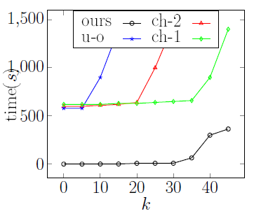
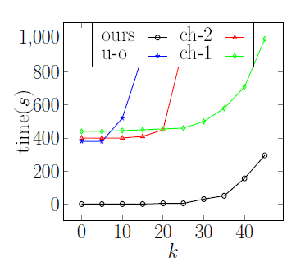
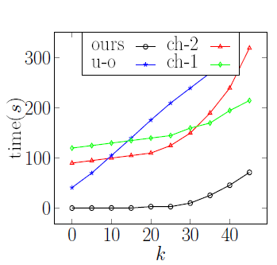
Experiments
Experiments on the string matching with large number of differences (for which the two-step method is used.)
  - Pattern length = 300 characters
  Gorilla Chr1
  Protein 1
  Protein 2
Notes:
On this slide, we show the test results on the other target strings with large k values.
Again, for them, our method still has much better performance.

Slide 38
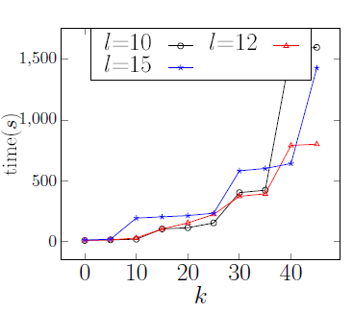
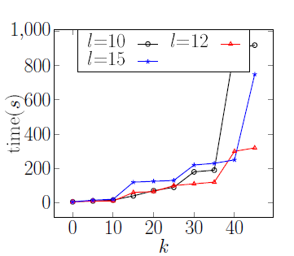
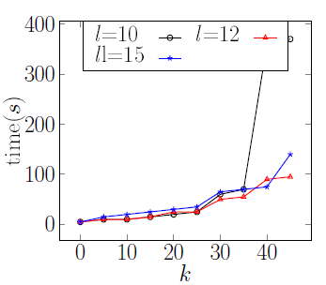
Experiments
Experiments on number of subpatterns
- Pattern length = 300 characters
  Gorilla genome
  ZebraFish genome
  Gorilla Chr1
l: the number of subpatterns
Notes:
On this slide, we show the impact of how a pattern is partitioned. From these figures, we can see that when k ≤ 40, whether a pattern is divided into 10, 12 or 15 subpatterns, the performance is almost the same. But when k is set to be 45, dividing a pattern into 15 or 12 subpatterns is obviously better that dividing a pattern into 10 subpatterns.

Slide 39
Experiments
  Number of segments checked in Step-2 by the pattern partition
K | 20 | 25 | 30 | 35 | 40 | 45
l =10 | 30.5k | 30.5k | 52.9k | 52.7k | 69.5k | 69k
l = 12 | 28.7k | 56.2k | 56.0k | 55.8k | 60.5k | 61.4k
l = 15 | 30.5k | 30.5k | 52.9k | 52.7k | 69.5k | 69.3k
Notes:
On this slide, we show the numbers of segments checked by different pattern-partition strategies. They are comparable for different strategies. This implies that the difference in performance mainly consists in the execution time of Step 1.

Slide 40
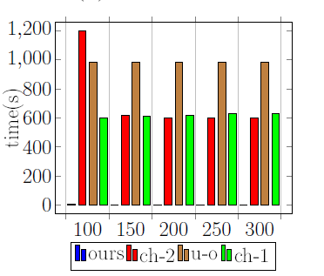
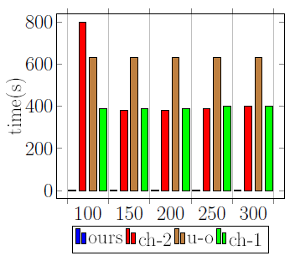
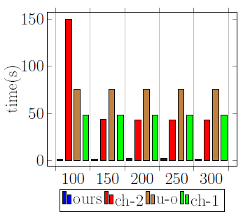
Experiments
Experiments on different lengths of patterns
  Gorilla genome
  ZebraFish genome
  Gorilla Chr1
Notes:
On this slide and the next slide, we show the impact of pattern lengths to the performance of a strategy.
From these figures, we can see that all their performance is not much changed for different pattern lengths, but consistently demonstrates a big difference between ours and all the tested online methods. All of them, including ours, are almost pattern-length independent.

Slide 41
Experiments
Experiments on different lengths of patterns
  Protein 1
  Protein 2
Notes:
These two figures are the test results on the two protein sequences with different lengths of patterns.
Again, they show that almost all the strategies are pattern-length independent.

Slide 42
Conclusion
Main contribution
- An algorithm for the string matching with k differences
Combination of dynamic programming and BWT indexes for the problem of string matching with k difference
Concept of search trees and two branch cutting methods
Pattern partition
- Extensive tests
Future work
- String matching with don’t care symbols (using BWT transformation as indexes)
Notes:
In summary, in this talk, I have discussed an algorithm for the string matching with k differences. The main idea of this algorithm is a Combination of dynamic programming paradigm and BWT indexes. During the execution of the algorithm, a search tree will be constructed to recognize all the occurrences of a pattern in the target string. Also, extensive experiments are conducted, demonstrating that our method is not only a theoretically, but also a practically efficient strategy.
As a future work, we will do the research on the string matching with don’t care symbols, but using the BWT transformation as indexes.

Slide 43
Thank you!

