Slide 1
Searching BWT against Pattern Matching Machine to Find Multiple String Matches
Dr. Yangjun Chen
Department of Applied Computer Science
University of Winnipeg
Canada

Slide 2
Outline
Motivation
- Statement of Problem
- Related methods
BWT Arrays – A Space-economic Index for String Matching
Our Method
- Searching BWT Arrays against pattern matching machines
- Multi-character searching
Experiments
Conclusion and Future Work

Slide 3
Statement of Problem
Mapping massive reads (short DNA sequences) to reference sequences is the central computational problem for NGS (Next Generation Sequencing) data analysis.
- Find all the occurrences of each read in a reference sequence
  - Millions to billions short-reads are mapped to a reference genome sequence for statistic analysis.
  - Ability to produce short-reads has outpaced our ability to process them.

Slide 4
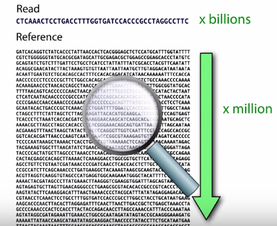
Short-Read Mapping
Millions to billions short-reads need to be mapped.
Reference genomes can be extremely large.
  Human genome 3 billion bases.
  Rat genome 2.9 billion bases.
Short-reads may contain base errors
compared to references. (Mismatch problem)
ACTACTGATC
CCTTGGACTACTGATCTTTAA

Slide 5
Related Methods
Different kinds of indexes: suffix trees, suffix arrays, hash tables
Example: reference sequence = atcat$
Indices can be big. For human: suffix tree > 50 Gb, suffix array > 12 Gb, hash table > 12 Gb.
i | Position | Suffix
1 | 6 | $
2 | 4 | at$
3 | 1 | atcat$
4 | 3 | cat$
5 | 5 | t$
6 | 2 | tcat$
t
at 1
at 4
nil
a
t
c
$
a
ca 3
nil
c
t
c
$
a
$
$
a
tc 2
nil
t
t
$
$
6
4
1
3
5
2
Suffix tree
Suffix array
Hash Table

Slide 6
Trie and Pattern Matching Machine
A trie over a set of pattern strings R = {r₁, …, r_{l}} is a tree such that each path in it corresponds to a r_{i} (1 ≤ i ≤ l).
Example 1 As an example, consider a set of four pattern strings:
r₁: acaga
r₂: ag
r₃: acagc
r₄: ca
v₀
€
v₁
a
c
v₁₁
v₂
c
v₉
g
{r₂}
{r₄}
a
v₁₂
v₃
a
{r₄}
v₁₀
$
$
v₁₃
v₄
g
{r₂}
v₅
a
{r₁}
c
v₇
{r₃}
v₆
$
$
v₈

Slide 7
Trie and Pattern Matching Machine
A Pattern Matching Machine over a set of pattern strings R = {r₁, …, r_{l}} is the corresponding trie plus a failure function.
v₀
Example 2
r₁: acaga
r₂: ag
r₃: acagc
r₄: ca
€
v₁
a
c
v₁₁
v₂
c
v₉
g
a
v₁₂
v₃
a
v₁₀
$
v₁₃
$
v₄
g
v₅
a
c
v₇
v₆
$
$
v₈

Slide 8
BWT-Index
Burrows-Wheeler Transform (BWT)
s = c₁c₂a₁g₁a₂c₃a₃$
Rank correspondence:
BWT construction:
  rk_{F}
  -
  1
  2
  3
  1
  2
  3
  1
F
L
  rk_{L}
  1
  1
  1
  2
  2
  3
  -
  3
  c₁ c₂ a₁ g₁ a₂ c₃ a₃ $
  c₂ a₁ g₁ a₂ c₃ a₃ $ c₁
  a₁ g₁ a₂ c₃ a₃ $ c₁ c₂
  g₁ a₂ c₃ a₃ $ c₁ c₂ a₁
  a₂ c₃ a₃ $ c₁ c₂ a₁ g₁
  c₃ a₃ $ c₁ c₂ a₁ g₁ a₂
  a₃ $ c₁ c₂ a₁ g₁ a₂ c₃
  $ c₁ c₂ a₁ g₁ a₂ c₃ a₃
  $ c₁ c₂ a₁ g₁ a₂ c₃ a₃
  a₃ $ c₁ c₂ a₁ g₁ a₂ c₃
  a₂ c₃ a₃ $ c₁ c₂ a₁ g₁
  a₁ g₁ a₂ c₃ a₃ $ c₁ c₂
  c₃ a₃ $ c₁ c₂ a₁ g₁ a₂
  c₂ a₂ g₁ a₂ c₃ a₃ $ c₁
  c₁ c₂ a₁ g₁ a₂ c₃ a₃ $
  g₁ a₂ c₃ a₃ $ c₁ c₂ a₁
L[i] = $,
if SA[i] = 1;
rank: 3
L[i] = s[SA[i] – 1],
otherwise.
SA[…] – suffix array
rank: 3
  rk_{F}(e) = rk_{L}(e)

Slide 9
Backward Search of BWT-Index
s = c₁c₂a₁g₁a₂c₃a₃$
Search p = aca
<z, [α, β]>,
if z appears in L_{π};
search(z, π) =
φ,
otherwise.
Backward Search
Z: a character π: a range in F
L_{π}: a range in L, corresponding to π
F L
$ a₃
a₃ c₃
a₂ g₁
a₁ c₂
c₃ a₂
c₂ c₁
c₁ $
g₁ a₁
F L
$ a₃
a₃ c₃
a₂ g₁
a₁ c₂
c₃ a₂
c₂ c₁
c₁ $
g₁ a₁
F L
$ a₃
a₃ c₃
a₂ g₁
a₁ c₂
c₃ a₂
c₂ c₁
c₁ $
g₁ a₁
F L
$ a₃
a₃ c₃
a₂ g₁
a₁ c₂
c₃ a₂
c₂ c₁
c₁ $
g₁ a₁
Suffix Array
  8
  7
  5
  3
  6
  2
  1
  4
position 5

Slide 10
Backward Search of BWT-Index
search(c, <a, [1, 3]>)
search(a, <c, [1, 3]>)
Search sequence:
<a, [1, 3]>
<c, [1, 3]>
<a, [2, 2]>
F L
$ a₃
a₃ c₃
a₂ g₁
a₁ c₂
c₃ a₂
c₂ c₁
c₁ $
g₁ a₁
F L
$ a₃
a₃ c₃
a₂ g₁
a₁ c₂
c₃ a₂
c₂ c₁
c₁ $
g₁ a₁
F L
$ a₃
a₃ c₃
a₂ g₁
a₁ c₂
c₃ a₂
c₂ c₁
c₁ $
g₁ a₁
F L
$ a₃
a₃ c₃
a₂ g₁
a₁ c₂
c₃ a₂
c₂ c₁
c₁ $
g₁ a₁
Suffix Array
  8
  7
  5
  3
  6
  2
  1
  4
10
10

Slide 11
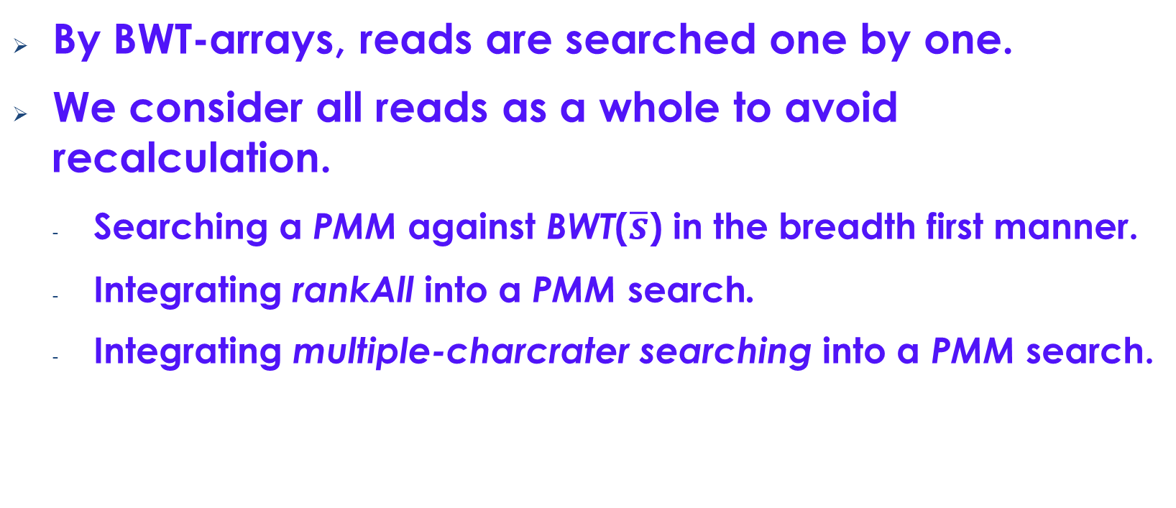
Our Approach
By BWT-arrays, reads are searched one by one.
We consider all reads as a whole to avoid recalculation.
  Searching a PMM against BWT($\overline{s}$) in the breadth first manner.
  Integrating rankAll into a PMM search.
  Integrating multiple-charcrater searching into a PMM search.

Slide 12
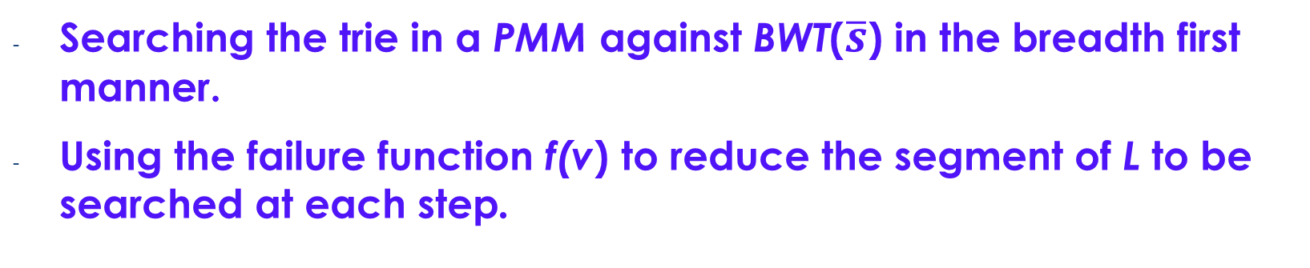
Searching PMM in BFS
  Searching the trie in a PMM against BWT($\overline{s}$) in the breadth first manner.
  Using the failure function f(v) to reduce the segment of L to be searched at each step.
v₀
€
r₁: acaga
r₂: ag
r₃: acagc
r₄: ca
s = c₁c₂a₁g₁a₂c₃a₃$
v₁
a
c
v₁₁
v₂
c
v₉
g
a
v₁₂
v₃
a
v₁₀
$
v₁₃
$
v₄
g
v₅
a
c
v₇
v₆
$
$
v₈

Slide 13
Searching Trie in BFS
Q:
<v₀, 1, 8>
<v₁, 1, 3>
<v₁₁, 1, 3>
<v₂, 1, 2>
<v₉, 1, 1>
<v₁₁, 1, 3>
<v₂, 1, 2>
<v₉, 1, 1>
<v₁₂, 2, 2>
<v₉, 1, 1>
<v₁₂, 2, 2>
<v₃, 2, 2>
(a)
(b)
(c)
(d)
(e)
<v₁₂, 2, 2>
<v₃, 2, 2>
<v₄, 1, 1>
<v₅, 3, 3>
<v₃, 2, 2>
(f)
(g)
(h)
(i)

Slide 14
Using f(v) to Reduce Searching Cost
  To calculate [α₂, β₂] for v₂, we will first try to derived them from [α₁, β₁] = [1, 3] for v₁, and [α₁₁, β₁₁] = [1, 3] for v₁₁.
  If α₂, β₂ cannot be derived, we will search L in a normal way.
  The derivation needs only a constant time.
v₀
€
v₁
a
c
v₁₁
v₂
c
v₉
g
a
v₁₂
v₃
a
v₁₀
$
v₁₃
$
v₄
g
v₅
a
c
v₇
v₆
$
$
v₈

Slide 15
Improvements
rankAll
Multiple-character checking

Slide 16
rankAll
Arrange |Σ| arrays each for a character α ∈ Σ such that A_{α}[i] (the ith entry in the array for α) is the number of appearances of α within L[1 .. i].
Instead of scanning a certain segment L[x .. y] (x ≤ y) to find a subrange for a certain α ∈ Σ, we can simply look up A_{α} to see whether A_{α}[x - 1] = A_{α}[y]. If it is the case, then α does not occur in L[x .. y]. Otherwise, [α[x - 1] + 1, α[y]] should be the found range.
Example
To find the first and the last appearance
of c in L[2 .. 4], we only need to find
c[2 – 1] = c[1] = 0 and c[4] = 2. So the
corresponding range is
[c[2 - 1] + 1, c[4]] = [1, 2].
F L
$ a₃
a₃ c₃
a₂ g₁
a₁ c₂
c₃ a₂
c₂ c₁
c₁ $
g₁ a₁
  A$ A_{a} A_{c} A_{g} A_{t}
  0 1 0 0 0
  0 1 1 0 0
  0 1 1 1 0
  0 1 2 1 0
          0 2 2 1 0
          0 2 3 1 0
  1 2 3 1 0
  1 3 3 1 0
16

Slide 17
Reduce rankAll-Index Size
F ranks: F_{x} = <x; α_{x}, β_{x} >
BWT array: L
Reduced appearance array: A_{x}
with bucket size π.
Reduced suffix array: SA* with
bucket size π.
top = F(x) + A_{x}[ ⎣(top-1)/π ⎦ ] + r +1
bot = F(x) + A_{x}[ ⎣bot/π ⎦ ] + r′
r is the number of α's appearances within L[⎣(top - 1)/π ⎦ ⋅π … top - 1]
r’ is the number of x's appearances within L[⎣bot/π ⎦ ⋅π … bot ]
  i
  1
  2
  3
  4
  5
  6
  7
  8
F L rk_{L}
$ a₃ 1
a₃ c₃ 1
a₂ g₁ 1
a₁ c₂ -
c₃ a₂ 2
c₂ c₃ 2
c₁ $ 3
g₁ a₁ 4
SA
L
a₃
c₂
g₁
c₂
a₂
c₃
$
a₂
  A$ A_{a} A_{c} A_{g} A_{t}
  0 1 0 0 0
  0 1 1 0 0
  0 1 1 1 0
  0 1 2 1 0
          0 2 2 1 0
          0 2 3 1 0
  1 2 3 1 0
  1 3 3 1 0
SA*
  8
  7
  5
  3
  6
  2
  1
  4
F_{x} = <x; α_{x}, β_{x} >
  8
  7
  5
  3
  6
  2
  1
  4
  F$ = <$; 1, 1>
  F_{a} = <a; 2, 4>
  F_{c} = <c; 5, 7>
  F_{g} = <g; 8, 8>
+
+
+

Slide 18
Multiple Character Searching
Search a trie structure
v₀
L
a₃
c₃
g₁
c₂
a₂
c₁
$
a₁
F
$
a₃
a₂
a₁
c₃
c₂
c₁
g₁
L
a₃
c₃
g₁
c₂
a₂
c₁
$
a₁
F
$
a₃
a₂
a₁
c₃
c₂
c₁
g₁
L
a₃
c₃
g₁
c₂
a₂
c₁
$
a₁
F
$
a₃
a₂
a₁
c₃
c₂
c₁
g₁
L
a₃
c₃
g₁
c₂
a₂
c₁
$
a₁
F
$
a₃
a₂
a₁
c₃
c₂
c₁
g₁
L
a₃
c₃
g₁
c₂
a₂
c₁
$
a₁
v₁
a
c
v₁₁
v₂
c
v₉
g
a
v₁₂
v₃
a
v₁₀
$
$
v₁₃
r₃
r₂
v₄
g
v₅
a
c
v₇
v₆
$
$
v₈
r₁
r₄
18
18

Slide 19
Multi-Character Checking
Multi-character checking when scanning a segment of L in BWT-index.
L:
B_{v}: a Boolean array associated with each node in a trie.
part of a trie:
1
4
2
4
1
2
3
3
3
4
1
3
4
1
2
3
a
t
c
t
a
c
g
a
c
t
a
g
t
a
c
g
C_{i}: a counter records the number of i’s appearances.
A
C
T
1
2
3
4
B_{v}:
1 1 0 1
B_{v}[L[i]] = 1?
If B_{v}[L[i]] = 1 then C_{L[i]} : = C_{L[i]} + 1
A
C
G
T
Counters:
C₁
C₂
C₃
C₄

Slide 20
Multi-Character Checking
Multi-character checking when scanning a segment of L in FM-index.
a
g
Part of a trie:
L:
[A:254, C:236, G:273, T:203]
a
t
c
t
a
c
g
a
c
t
a
g
t
a
c
g
.
.
.
.
.
.
.
.
.
.
.
.
.
.
.
.
.
.
.
.
.
.
.
.
.
.
.
.
.
.
.
.
A
c
T
B_{v}: a Boolean array associated with each node in trie.
B_{v}[L[i]] = 1?
1
2
3
4
Rank:
A: 257
C: 238
T: 203
1 1 0 1
C_{i}: a counter records the number of i’s appearances.
A
C
G
T
C₁
C₂
C₃
C₄

Slide 21
Experiments
Compare 6 different approaches
- Burrows Wheeler Transformation (BWT for short),
- Suffix tree based (Suffix for short),
- Hash table based (Hash for short),
- Commentz-Walter’s Algorithm [6] (CW for short),
- Crochemore’s Algorithm [18] (Cr for short), and
- pmmS (pS for short, discussed in this paper).

Slide 22
Experiments
TABLE I. CHARACTERISTICS OF GENOMES
Genomes | Genome sizes (bp)
Rat chr1 (Rnor_6.0) | 290,094,217
C. merolae (ASM9120v1) | 16,728,967
C. elegans (WBcel235) | 103,022,290
Zebra fish (GRCz10) | 1,464,443,456
Rat (Rnor_6.0) | 2,909,701,677

Slide 23
Tests with Synthetic Data
Tests with varying amount of reads (over Rat chr1)
time (s)
time (s)
amount of reads with length 100 pbs (million)
amount of reads with length 50 pbs (million)

Slide 24
Tests with Synthetic Data
Tests with varying amount of reads (over C. merolae )
time (s)
time (s)
amount of reads with length 50 pbs (million)
amount of reads with length 100 pbs (million)
24

Slide 25
Tests with Synthetic Data
Tests with varying length of reads (over Rat chr1)
200 million reads
500 million reads
time (s)
time (s)
read length (pb)
read length (pb)
25
25

Slide 26
Tests with Synthetic Data
Tests with varying length of reads (over C. merlae)
200 million reads
500 million reads
time (s)
time (s)
read length (pb)
read length (pb)
26
26
26

Slide 27
Tests with Real Data
  500 million single reads produced by Illumina from a rat sample.
  Length of these reads: 36 bps and 100 bps after trimming using Trimmomatic .
  The reads divided into 9 samples with different amount: between 20 and 75 million.
  mapping the 9 samples back to rat genomes
time (s)
time (s)
  mapping the 9 samples back to rat genome of ENSEMBL release 79
  mapping the 9 samples back to the Rat transcriptome
27

Slide 28
Conclusion and future work
Main contribution
- Searching pattern matching machines against BWT indexes
- Multi-character checking
- Extensive tests
Future work
- Adapt our matching algorithm for protein sequences
- String matching with k Mismatch, k errors, or don’t care symbols

Slide 29
Thank you!

Slide 30
Varying Read Amount
Genome size = chromosome 1 of Rat genome, 290,094,217 bp.
Read length = 50 bp
No. of reads (bp) | 30M | 35M | 40M | 45M | 50M
Time for trie construction | 61s | 73s | 82s | 95s | 110s
No. of reads (bp) | 30M | 35M | 40M | 45M | 50M
TFM | 76608K | 88885K | 101023K | 113035K | 124920K
ITFM | 72011K | 81774K | 91425K | 101731K | 111553K

Slide 31
Varying Read Amount
Genome size = chromosome 1 of Rat genome, 290,094,217 bp.
Read length = 100 bp

Slide 32
Varying Read Length
Genome size = chromosome 1 of Rat genome, 290,094,217 bp.
Read amount = 20 and 50 million

Slide 33
Varying Genome Size
5 different genomes:
Genome Name | Genome Size (bp)
C. merlae (ASM9120v1) | 16,728,967
C. elegans (WBcel235) | 103,022,290
Rat chromosome 1 (Rnor_6.0) | 290,094,217
Zerbra fish (GRCz10) | 1,464,443,456
Rat (Rnor_6.0) | 2,909,701,677

Slide 34
Varying Genome Size
Read amount = 50 million.
Read length = 50 bp and 100 bp.

Slide 35
Varying Bucket Size of
Appearance Array
Read amount = 20 million.
Read length = 100 bp.

Slide 36
Experiments with Real Data
Dataset: 5 rat samples [10]
Read length = 50 bp
Sample ID | S1 | S2 | S3 | S4 | S5
No. of reads (bp) | 63,058,350 | 70,902,476 | 46,768,753 | 52,830,741 | 73,558,762

Slide 37
Experiments with Real Data
Dataset: 6 rat samples [10]
Read length = 36-100 bp
Sample ID | S1 | S2 | S3 | S4 | S5 | S6
No. of reads | 71,160,190 | 66,203,093 | 47,937,592 | 74,941,568 | 53,839,641 | 74,663,544

Slide 38
Experiment of Inexact Mapping
Read length = 50 bp. Read amount = 46,768,753.
Mismatches allowed = 3.
Methods Compared:
  Our method, denoted by ITFM.
  Hash table constructed over reference genome, denoted by Hash Table (reference).
  FM-index start inexact search when exact matching fails, denoted by FM-index (break point).
  FM-index start inexact search from 10th base of reads, denoted by FM-index (10th base).

Slide 39
Experiment Result of Inexact Mapping
Method | Time (s) | Mapping Rate
ITFM | 1573 | 85.3%
FM-index (break point) | 1426 | 84.4%
FM-index (10th base) | 2208 | 85.5%
Hash table (reference) | 2320 | 87%

Slide 40
Memory Usage
Hash table constructed over Rat genome : ~13 Gb.
FM-index for Rat genome: ~5 Gb.
Our method: ~14.2 Gb.
  FM-index: ~5 Gb.
  Trie for ~50 million 100 bp reads: around ~9.2 Gb.

Slide 41
Conclusion
Introduced DNA sequencing technologies.
Reviewed related short-reads mapping approaches.
Presented the method combining trie and FM-index for matching massive short-reads.
Experiment results demonstrated that our method can reduce the running time of the traditional FM-index search for big set of short-reads for mammalian-sized genome databases.

Slide 42
Future Work
Further reduce memory usage of trie.
Adapt our matching algorithm for protein sequences.
Introducing mapping quality, rank matches by mapping quality.

Slide 43
References
[1] S. Andrews, “Babraham Bioinformatics - FastQC,” 2010, http://www.bioinformatics.babraham.ac.uk/projects/fastqc/.
[2] Bolger, A. and Giorgi, F., Trimmomatic: A flexible read trimming tool for Illumina NGS data. URL http://www.usadellab.org/cms/index.php?page=trimmomatic.
[3] Langmead, Ben et al. “Ultrafast and Memory-Efficient Alignment of Short DNA Sequences to the Human Genome.” Genome Biology 10.3 (2009).
[4] D. Kim, G. Pertea, C. Trapnell, H. Pimentel, R. Kelley, and S. L. Salzberg, “TopHat2: accurate alignment of transcriptomes in the presence of insertions, deletions and gene fusions.” Genome biology, vol. 14, no. 4, p. R36, Apr. 2013.
[5] Trapnell, C., Williams, B. a., Pertea, G., Mortazavi, A., Kwan, G., van Baren, M. J., Salzberg, S. L., Wold, B. J. and Pachter, L., Transcript assembly and quantification by RNASeq reveals unannotated transcripts and isoform switching during cell differentiation. Nature Biotechnology, 28,5(2010), pp, 511– 5.
[6] Robinson MD, McCarthy DJ and Smyth GK (2010). “edgeR: a Bioconductor package for differential expression analysis of digital gene expression data.” Bioinformatics, 26, pp. -1.
[7] Anders S, Reyes A and Huber W (2012). “Detecting differential usage of exons from RNA-seq data.” Genome Research, 22, pp. 4025.
[8] P. Ferragina and G. Manzini, Opportunistic data structures with applications. In Proc. 41st Annual Symposium on Foundations of Computer Science, pp. 390 - 398. IEEE, 2000.
[9 H. Li, wgsim: a small tool for simulating sequence reads from a reference genome, https://github.com/lh3/wgsim/, 2014.
[10] Xie’s lab website: http://home.cc.umanitoba.ca/~xiej/, 2014.
[11] Li H, Ruan J, Durbin R. Mapping short DNA sequencing reads and calling variants using mapping quality scores. Genome research ,2008,18(11): 1851-1858.
[12] Li R, Li Y, Kristiansen K, Wang J. SOAP: short oligonucleotide alignment program. Bioinformatics, 2008,24(5):713-714.
[13] S Bauer, M H Schulz, P N Robinson, gsuffix, URL http:://gsuffix.Sourceforge.net/, 2014.
[14] Wu, Z., Jia, X., de la Cruz, L., Su, X.C., Marzolf, B., Troisch, P., Zak, D., Hamilton, A., Whittle, B., Yu, D., Sheahan, D., Bertram. (2008). Immunity 29, this issue, 863–875.
[15] J. C. Venter, M. D. Adams, and E. W. Myers et al. The sequence of the human genome. Science, 291(5507):1304–1351, Feb 2001.

Slide 44
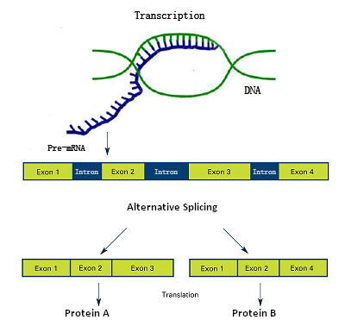
Biology Background
DNA
Gene
  Exon
  Intron
Alternative splicing
Transcript
[15]

Slide 45
Differential Alternative Splicing Analysis
Find differences in exon splicing patterns among different biological conditions.
Detect the differences by analyzing distribution of short-reads (expression level).
Wu et al. [14]
hnRNP LL regulation
5’
5
6
7
33
3’
1
3
4
Naive T Cell
5’
3’
1
3
4
5
6
7
33
Memory T Cell
5’
3’
1
3
7
33

Slide 46
Pipeline Tool Motivation
Analyzing NGS data is complicated.
  Multiple phases are needed.
  Differential alternative splicing analysis is not settled down into definite “best practice”, several methods are available.
  Typically many samples in an experiment will be processed in the same way.

Slide 47
Pipeline Workflow
CGCTCG
TCGACG
CGACGT
GTGA…
.
.
Control_1
Control_2
Treatment_1
Treatment_2
Raw reads
Quality assessment for whole library.
Trim low quality 3’ end sequences.
Remove low quality reads.
Remove overrepresented sequences.
Cleaning reads
CGACGT
TCGACG
CGCTCG
GTGA…
Only reads that pass the cleaning step are remained.
Map cleaned short-reads against transcriptome.
…ATCGCTCGACGACGTGA…
Mapping reads
Count mapped reads for each element at exon level.
Detect alternative splicing by exact test.
Filter counting bins with low counts
Report a table of detected alternative splice sites.
Expression analysis
Exon1
Exon2
Exon3

Slide 48
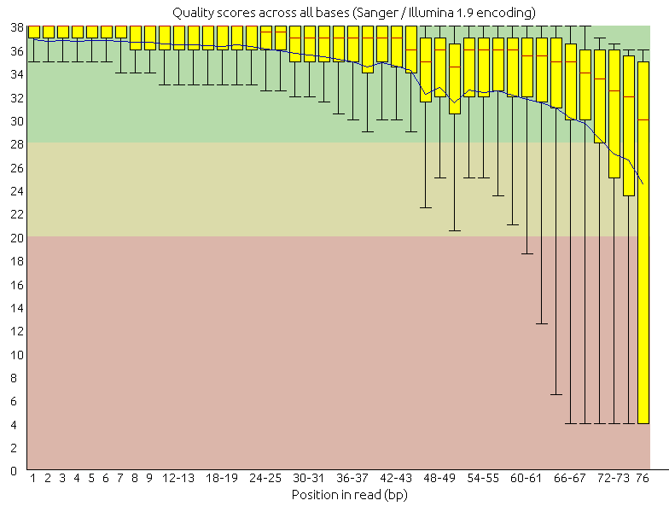
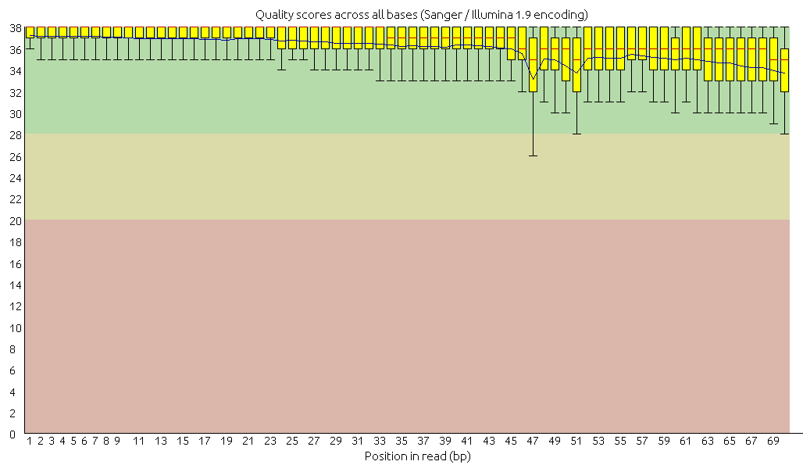
Cleaning Raw Reads
Sequencer may generate poor quality reads.
  Use FastQC [1] to assess quality of reads.
  Use Trimmomatic [2] to clean reads: trailing quality < 28, minimum length = 32 bp.
before cleaning
after cleaning

Slide 49

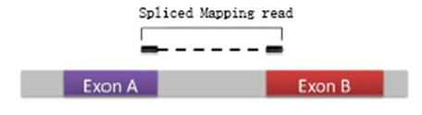
Strategies of mapping
Unspliced mapper.
  Bowtie [3]. Best for analysis within known genes.
Spliced mapper.
  Tophat [4]. Best for unknown exon, gene detection.
We use Bowtie in our pipeline.
  Map reads to transcriptome.
  Increase accurate rate of mapping.
  Increase mapping speed.

Slide 50
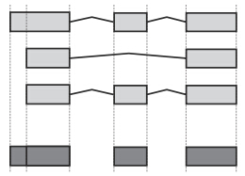
Strategies of Quantitative Evaluation
Transcript estimation based. e.g. Cufflinks [5].
  Direct way.
  Lack of accuracy.
Count at gene level. e.g. edgeR [6].
  Simple.
  Miss many results.
  Count at exon level. e.g. DEXSeq [7]
transcript1:
transcript2:
transcript3:
Divided counting bins:

Slide 51
Filter Results
Counting bins with low number of reads assigned may be wrongly detected.
We shouldn’t merely rule out counting bins by raw counts, as the influence of sequencing depth should be considered.
Use normalization model count per million (CPM).
  CPM_{e} = r_{e} × (10⁶ / N)
Filter out counting bins with CPM < 0.2 in all experimental groups.

Slide 52
Comparison with Existing Pipeline
Implementation: Combine python, bash, R scripts incorporating publicly available tools.
Compare with Tophat-Cufflinks pipeline. Dataset: hnRNP L&LL regulation[10]
Analytical category | Pipeline name | Performance | Time
Preprocessing | Ours (FastQC) | 85% good quality reads | 47 min
Preprocessing | T-C (FastQC) | 85% good quality reads | 47 min
Read mapping | Ours (Bowtie) | 86.5% reads mapped | 7 h
Read mapping | T-C (Tophat) | 93.2% reads mapped | 13 h
Differential expression | Ours (DEXSeq) | 270 bins differentially used | 2 h
Differential expression | T-C (Cufflinks) | 607 transcripts differentially expressed | 5 h
Experimental Validation:
Ours: 60% (6 out of 10)
T-C: 30% (3 out of 10)

Slide 53
Varying Read Amount
Genome size = chromosome 1 of Rat genome, 290,094,217 bp.
Read length = 50 and100 bp
Find 10 appearance locations

Slide 54
Varying Read Length
Genome size = chromosome 1 of Rat genome, 290,094,217 bp.
Read amount = 20 and 50 million
Find 10 appearance locations

Slide 55
Varying Read Amount
Genome size = C. merlae, 16,728,967 bp.
Read length = 50 and100 bp

Slide 56
Varying Read Length
Genome size = C. merlae, 16,728,967 bp.
Read amount = 20 and 50 million

Slide 57
Varying Genome Size
Read amount = 20 and 50 million.
Read length = 50 bp.

Slide 58
Varying Genome Size
Read amount = 20 and 50 million.
Read length =100 bp.

