Slide 1
Graph Decomposition and Recursive
Closures

Slide 2
Implementation of Graph Decomposition and Recursive Closures
Graph Decomposition and Recursive Closures was published in 2003 by Professor Chen. The project is an implementation of the algorithm described in the paper.
The main idea behind this is tree labeling and graph decomposition . It is a better computational complexity than any existing algorithms for this problem.

Slide 3
The main purpose of my project is to predict whether there are or are not any relations between two random nodes from a graph.

Slide 4
Design algorithm
Graph generation
Find a tree
Find topological sequence of the graph
Scan along the topological sequence and construct a pair sequence for each node

Slide 5
Data structure design
 |  | pre | post
• | a | 2 | 5 | •
• | b | 7 | 7 | •
• | c | 3 | 3 | •
• | d | 8 | 6 | •
• | e | 4 | 1
• | f | 5 | 2
• | g | 6 | 4
/ | (2,5)
c | •
g | /
/ | (7,7)
• | (6,4)
• | (5,2)
• | (4,1)
d | /
/ | (3,3)
e | •
f | /
/ | (8,6)
• | (6,4)
• | (5,2)
• | (4,1)
f | •
g | /
/ | (4,1)
/ | (5,2)
/ | (6,4)
• | (5,2)
• | (4,1)

Slide 6
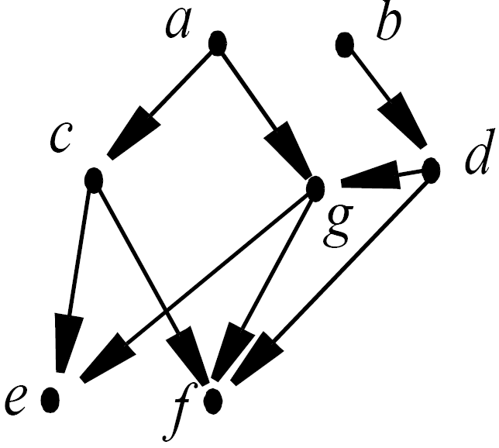
1.Graph generation
The graph is saved in a txt file.
Read from file and store in a link list.
Graph.txt
Graph
a | •
b | •
c | •
d | •
e
f
g
c | •
g | /
a c
c e
c f
a g
g e
g f
b d
d g
d f
d | /
e | •
f | /
f | •
g | /

Slide 7
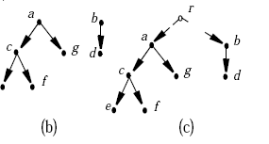
2.Find a tree
Find the maximal branching of the graph
Introduce a virtual root r for the branching and an edge r r_{i} for each T_{i}, obtaining a tree G_{r}.
(a)

Slide 8
2.Find a tree
Preorder numbers are generated for the tree nodes during a depth-first search.
Postorder numbers are generated for the tree nodes during a bottom-up search.
For any directed tree G_{r}, we can label it as follows. By traversing G_{r} in preorder, each node v will obtain a number pre(v) to record the order in which the nodes of the tree are visited.
In a similar way, by traversing T in postorder, each node v will get another number post(v).

Slide 9
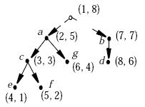
These two numbers can be used to characterize the ancestor-descendant relationships of nodes as follows.
Let v and v’ be two nodes of a tree T. Then, v’ is a descendant of v if pre(v’) >pre(v) and post(v’) < post(v).

Slide 10
3.Find topological sequence of the graph
Topological-Sort (G)
call DFS(G) to compute finishing times f [v] for all v ∈ V
as each vertex is finished, insert it onto the front of a linked list
return the linked list of vertices

Slide 11
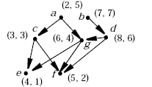
If a node v is labeled with (pre, post) in G_{r}, it will be initially labeled with the same pair (pre, post) in G.
Gr Tree labeling Graph labeling

Slide 12
sort the nodes of G topologically
b d a g c f e
(V_{i}, V_{j}) ∈ E implies V_{j} that appears before V_{i} in the sequence of the nodes.
Find a topological sequence of the graph:
e, f, c, g, a, d, b

Slide 13
4.Scan along the topological sequence and construct a pair sequence for each node
Scan the topological sequence of the nodes from the beginning to the end and at each step we do the following:
To compute the pair sequence for each node.The pairs to be generated for a node v are simply stored in a link list A_{v}.

Slide 14
Let v₁, ..., v_{k} be the children of v. Merge A_{v} with each A_{vi} for the child node v_{i} (i = 1, ..., k) as follows. Assume A_{v} = p₁ → p₂ → ... → p_{g} and A_{vi}= q₁ → q₂ → ... → q_{h},
We step through both A_{v} and from left to right. Let p_{i} and q_{j} be the pairs encountered. We’ll make the following checkings.
(1) If p_{i.}pre > q_{j.}pre and p_{i.}post > q_{j.}post, insert q_{j} into A_{v} after p_{i-1} and before p_{i} and move to q_{j+1}.
(2) If p_{i.}pre > q_{j.}pre and p_{i.}post < q_{j.}post, remove p_{i} from A_{v} and move to p_{i+1}. (*p_{i} is subsumed by q_{j.*} )
(3) If p_{i.}pre < q_{j.}pre and p_{i.}post > q_{j.}post, ignore q_{j} and move to q_{j+1.} (*q_{j} is subsumed by p_{i}; but it should not be removed from A_{vi.*} )
(4) If p_{i.}pre < q_{j.}pre and p_{i.}post < q_{j.}post, ignore p_{i} and move to p_{i+1}.
(5) If p_{i} = p_{j}’ and q_{i} = q_{j}’, ignore both (p_{i}, q_{i}) and (p_{j}’, q_{j}’), and move to (p_{i+1}, q_{i+1}) and (p_{j+1}’,q_{j+1}’), respectively.

Slide 15
Scan the topological sequence of the nodes from the beginning to the end .
e(4,1), f(5,2), c(3,3) g(6,4), a(2,5), d(8,6), b(7,7)
Compute the pair sequence for each node:
For example:
c(3,3) • A_{c} (3,3) g(6,4)• A_{g}(4,1) (5,2) (6,4)
e(4,1) • • f(5,2) e(4,1)• •f(5,2)
A_{e}(4,1) A_{f}(5,2) A_{e}(4,1) A_{f}(5,2)

Slide 16
Result of all the nodes :
A_{e} (4,1)
A_{f} (5,2)
A_{c} (3,3)
A_{g} (4,1)→(5,2)→(6,4)
A_{a} (2,5)
A_{d} (4,1)→(5,2)→(6,4)→(8,6)
A_{b} (4,1)→(5,2)→(6,4)→(7,7)

Slide 17
Data Structure
 |  | pre | post
• | 1 | 2 | 5 | •
• | 2 | 7 | 7 | •
• | 3 | 3 | 3 | •
• | 4 | 8 | 6 | •
• | 5 | 4 | 1
• | 6 | 5 | 2
• | 7 | 6 | 4
/ | (2,5)
3 | •
7 | /
/ | (7,7)
• | (6,4)
• | (5,2)
• | (4,1)
4 | /
/ | (3,3)
5 | •
6 | /
/ | (8,6)
• | (6,4)
• | (5,2)
• | (4,1)
6 | •
7 | /
/ | (4,1)
/ | (5,2)
/ | (6,4)
• | (5,2)
• | (4,1)

Slide 18
Thank you !

