Slide 1
University of Winnipeg Quad-tree Prepared By
Tariq Alusaifeer
Prepared For
Professor/ Yangjun Chen
March, 2010

Slide 2
Outline
Introduction to Quad-Tree.
How to divide nodes to blocks.
Example for the division process.
Representing the Example in a Quad-tree.
How to store a Quad-Tree into a file.
Conclusion.

Slide 3
Quad-Tree is a tree data structure in which each internal node corresponds to a square region in two dimensions or more.
Each node has up to four children (MAX).
If the number of data entries in a square is not larger than what will fit in a block, then we can think of this square as a leaf node.
If there are too many data entries to fit in one block, then we treat the square as an interior node, whose children correspond to its
four quadrants.

Slide 4
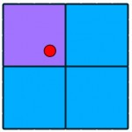
Dividing nodes to Blocks

Slide 5
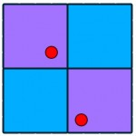

Slide 6
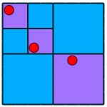

Slide 7
Example of the Dividing Process
B
E

Slide 8
F
B
E

Slide 9
F
B
G
E

Slide 10
F
B
G
H
E

Slide 11
F
B
G
H
E
J
K
L
M

Slide 12
Representing the Blocks to a Quad-Tree
A
B
B
E

Slide 13
A
F
B
B
C
G
F
G
E

Slide 14
A
F
B
B
C
D
G
F
G
H
H
E

Slide 15
A
F
B
B
C
D
G
F
G
H
I
H
E
J
K
J
K
L
M
L
M

Slide 16
A
F
B
B
C
D
E
G
F
G
H
I
H
E
J
K
J
K
L
M
L
M

Slide 17
How to store Quad-tree into a file
Depth-first-search same as B+ -tree as Follow:
(*non-recursive strategy*)
push(root);
while (stack is not empty) do
{ x := pop( );
print(v); (*or store v in a file.*)
let v₁, …, v_{k} be the children of v;
for (i = k to 1) {push(v_{i})};
}

Slide 18
Thank You

