Slide 1
Bitmap Index
Web and Document Databases - ACS-7102
Buddhika Madduma
22/03/2010

Slide 2
Outline
Introduction
Background
Methodology
Evaluation

Slide 3
Introduction
What is Bitmap Index?
- A bitmap index is a special kind of database index that uses bitmaps
Notes:
Bitmap indexes have traditionally been considered to work well for data such as gender, which has a small number of distinct values, e.g., male and female
Bitmap indexes have a significant space and performance advantage over other structures for such data.

Slide 4
Introduction cont....
Bitmap indexes use bit arrays (commonly called "bitmaps") and answer queries by performing bitwise logical operations on these bitmaps
ORACLE, Sybase, and IBM have implemented them in their respective DBMS products.

Slide 5
Background
Any Bitmap Index implementation should be considered following two main issues
  Space constraint
  Query time constraint

Slide 6
Background cont....

Slide 7
Design & Development Phase
Data(recodes) population on CSV file
Bitmap index file generation
Development of bitmap Index compression algorithm
Design of Record Retrieval mechanism based on compressed Bitmap Index

Slide 8
Bitmap Index Generation
File Name,
Attribute Name,
Start Row ID,
Block Size,
Create Code Array
Create Bitmap
Compress Bitmap
Write to file Sequentially

Slide 9
Creation of Code Array
2D Array creates on memory (heap)- [x][y]
- x is the Cardinality of given attribute in
table
- y is the Row count (block size)

Slide 10
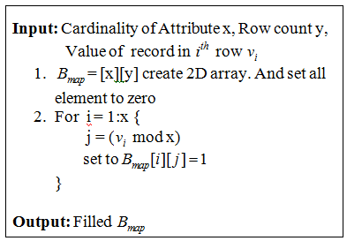
Bitmap Generation

Slide 11
Bitmap Compression
Available Compression Techniques
- LZ77 general purpose text compression
- RLE most common form of compression
- BBC (Byte-aligned Bitmap Code)
- WAH (Word-Aligned Hybrid code)
Notes:
1. LZ77 These schemes are efficient in reducing file sizes. However, performing logical operations on the compressed bitmaps is usually much slower than on the uncompressed bitmaps.
2. The encoding scheme of WAH is simpler than BBC. Therefore WAH is faster than BBC
3. The words in WAH compressed bitmaps have no dependency among them, but the bytes in BBC have complicated dependencies. Therefore, accessing BBC compressed bitmaps is more complicated and more time consuming than accessing WAH compressed bitmaps.

Slide 12
WAH compression
WAH stores the compressed data in computer Words
- 32bit CPU => 32 bit word 64bit CPU => 64bit word
It only has two types of words
- literal words
- fill words

Slide 13
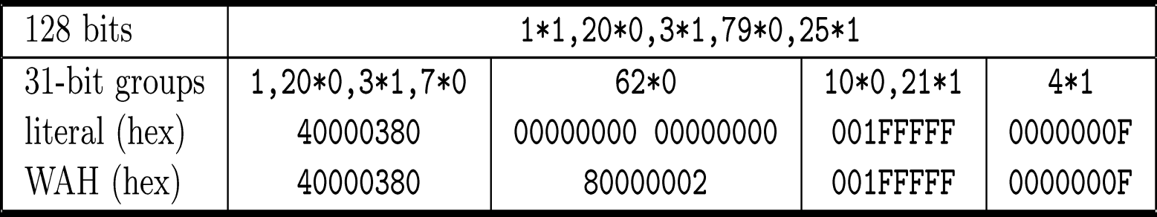
Example - WAH compression
First line is the original Bit vector
In this example, we assume 32 bit words
each literal word stores 31 bits from the bitmap
each fill word represents a multiple of 31 bits
second line shows how the bit vector is divided
into 31-bit groups
third line shows the hexadecimal representation
of the groups

Slide 14
Record Retrieval-Query Processing
INPUT
File Name,
Attribute Names,
Search Operator,
Combine Bitmaps
Row ID List
Print Results

Slide 15
Record Retrieval- Cont....
Time to read the bitmaps is known to be a linear function of the total size of the bitmaps
To perform a logical operation such as OR, AND, we essentially need to match each 31-bit group from the two operands

Slide 16
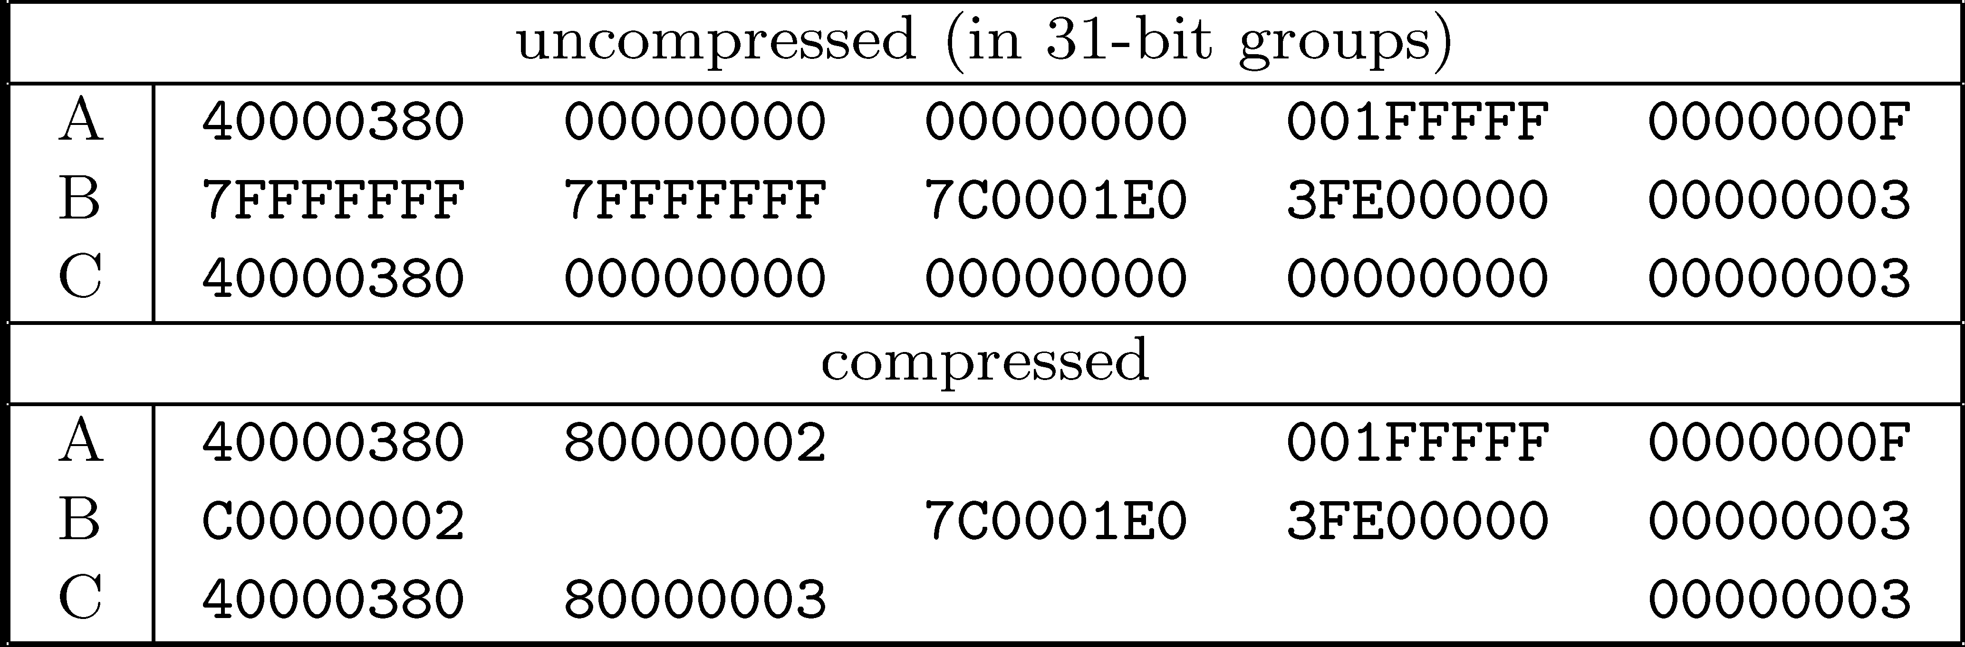
Example – Record Retrieval
C = A AND B

Slide 17
Experiment Setup
C++ programming Language will be used to developed the proposed Algorithm
Windows 32bit OS will be the Platform
Experiments will be carried out and recorded the Query response time and Space overhead

Slide 18
Thank You.

